Slide 1

Enhancing Risk Management with Data
September 15, 2024
Notes:
Welcome, thank you for being here today.

Slide 2

Title Slide
Introduction
Enhancing Risk Management with Data Analytics and ERM Tools at Company XYZ
Presentation to Stockholders
Date: September 15th, 2024
Presenter: Rachel Goldsbury
Notes:
I’m Rachel Goldsbury, and today I will be presenting our enhanced approach to risk management for Company XYZ. This presentation will cover the current challenges, proposed solutions, and how data analytics can significantly improve our risk assessment and management practices.

Slide 3

Introduction
Objective
The objective of this presentation is to present Company XYZ’s risk management challenges, proposed solutions, and the benefits of data analytics in enhancing risk assessment and management.
There is a significant need for improved risk management and data analytics.
Notes:
The core of our discussion will highlight the crucial role of data analytics. As we navigate through this presentation, I’ll demonstrate how leveraging advanced analytics not only improves our risk management strategies but also provides a more accurate, data-driven approach to mitigating risks.The objective of this presentation is to present Company XYZ’s risk management challenges, proposed solutions, and the benefits of data analytics in enhancing risk assessment and management.
There is a significant need for improved risk management and data analytics.

Slide 4


Organizational Background and Goals
Background
Company Overview and Challenges
Goals for Risk Management
Company XYZ is a leading property and casualty insurer.
Current challenge includes elevated operational losses due to fraudulent auto accident personal injury claims.
The organization faces increasing pressure to enhance risk management practices.
Fraudulent claims have led to significant financial impacts, necessitating immediate action.
Improve risk management efficiency across the organization.
Reduce fraud losses significantly through enhanced detection methods.
Integrate risk data organization-wide to enhance decision-making.
Establish a proactive approach to risk management that anticipates potential threats.
Notes:
Company Overview and Challenges Company XYZ is a leading property and casualty insurer.
Current challenge includes elevated operational losses due to fraudulent auto accident personal injury claims.
The organization faces increasing pressure to enhance risk management practices.
Fraudulent claims have led to significant financial impacts, necessitating immediate action. Goals for Risk Management: Improve risk management efficiency across the organization.
Reduce fraud losses significantly through enhanced detection methods.
Integrate risk data organization-wide to enhance decision-making.
Establish a proactive approach to risk management that anticipates potential threats.

Slide 5
Current Risk Management Practices and Limitations
Risk Management
Existing Programs
Limitations
Special Investigations Unit (SIU) actively investigates fraudulent claims.
Claims adjudication system processes claims to determine validity and liability.
Manual investigations are conducted to gather additional evidence and assess claims.
SIU is understaffed, limiting its capacity to handle the volume of claims.
Inefficiencies arise from reliance on manual processes, leading to delays in investigations.
Limited capacity for handling large volumes of suspicious claims results in potential risks being overlooked.
Notes:
Currently, our Special Investigations Unit (SIU) handles suspicious claims, but it is overwhelmed by the volume. Our risk assessment techniques, including manual investigations and historical data analysis, are somewhat effective but limited due to the SIU’s capacity and the manual nature of these processes. This leads to inefficiencies and missed opportunities to mitigate risks.

Slide 6
Macro-Level Risk Categories
Operational Risk: Fraudulent claims necessitate improved processes.
Credit Risk: Defaults on reinsurance contracts or premium payments require monitoring client creditworthiness.
Market Risk: Investment fluctuations can affect policy backing; a strong investment strategy is essential.
Liquidity Risk: Adequate liquidity is crucial for claims payouts; robust liquidity management ensures obligations are met.
Business Risk :Increased competition necessitates adaptive strategies for sustained success.
Reputational Risk: Fraud-related publicity can harm reputation; proactive claims management and effective communication are key.
Systematic Risk: Economic downturns necessitate portfolio diversification to mitigate widespread losses.
Moral Risk: Employee incentives can lead to fraudulent claims; strong ethical guidelines are necessary to reduce moral hazard.
Notes:
Macro risk refers to the broader, high-level risks that impact an entire organization or industry, arising from external factors beyond its control, including economic, political, and environmental influences that can affect market conditions and operational performance, such as economic downturns, regulatory changes, and systemic risks in financial markets.
Operational Risk:
Operational risk involves losses resulting from inadequate or failed processes, people, systems, or external events.
For Company XYZ, the issue of fraudulent claims highlights the need for improved processes to mitigate this risk effectively.
Credit Risk:
Credit risk refers to the potential loss arising when a borrower fails to meet their obligations.
In the context of Company XYZ, it's vital to monitor client creditworthiness to prevent defaults on reinsurance contracts or premium payments, which could negatively impact financial stability.
Market Risk:
Market risk encompasses losses due to adverse price movements in financial markets.
For Company XYZ, fluctuations in investments can directly affect the value of policies. Therefore, a strong investment strategy is essential to buffer against potential market volatility.
Liquidity Risk:
Liquidity risk is the risk of being unable to meet financial obligations as they come due.
For Company XYZ, maintaining adequate liquidity is crucial for ensuring that claims can be paid promptly. A robust liquidity management framework is necessary to fulfill obligations even during challenging times.
Business Risk:
Business risk involves losses resulting from a firm’s business model or strategy.
Given the increased competition in the insurance industry, Company XYZ must adopt adaptive strategies to ensure sustained success and navigate market dynamics effectively.
Reputational Risk:
Reputational risk is the potential loss that arises from negative public perception of the organization.
For Company XYZ, negative publicity related to fraudulent claims could severely harm its reputation. Proactively managing claims and communicating effectively with stakeholders are key to protecting the company’s image.
Systematic Risk:
Systematic risk refers to the risk of collapse in an entire financial system or market, often due to systemic events.
For Company XYZ, economic downturns can lead to widespread losses. Thus, diversifying investment portfolios is crucial to mitigate this risk and stabilize the organization’s financial standing.
Moral Risk:
Moral risk is the risk that arises when a party has incentives to take undue risks because they do not bear the full consequences of their actions.
In the context of Company XYZ, employee incentives to approve claims could lead to fraudulent activities. Implementing strong ethical guidelines and oversight is essential to reduce this moral hazard.

Slide 7
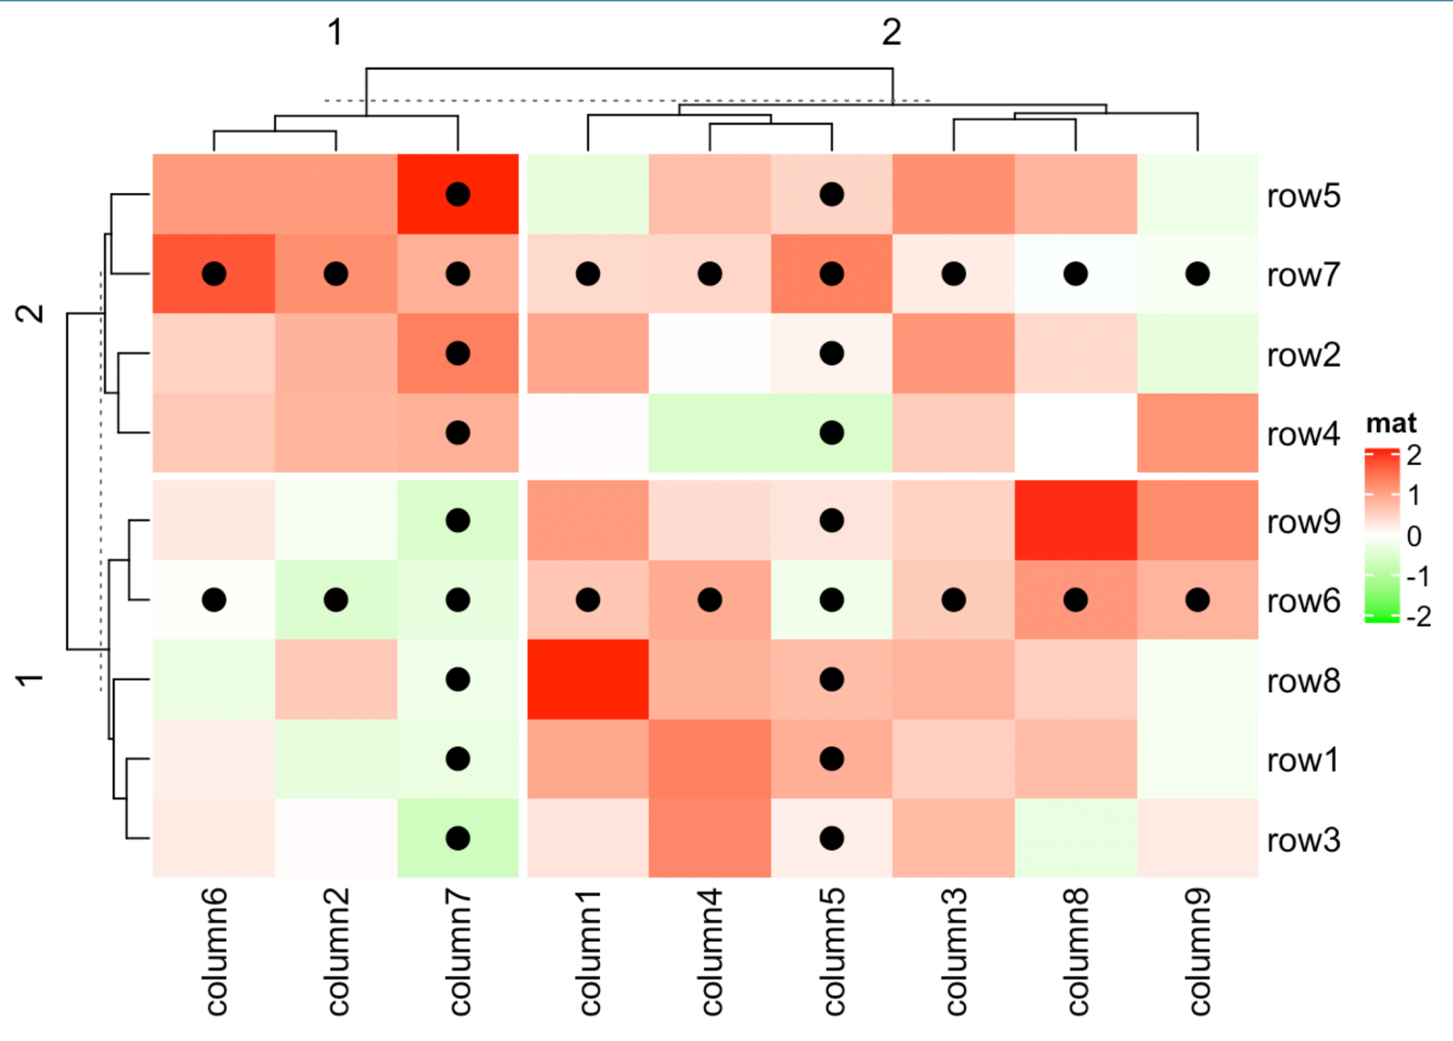
Macro-Level Risks Visualization
Visualization
Heatmap Visualization of Operational Risks
The heatmap visualization displays the distribution and severity of operational risks across different departments within Company XYZ.
It highlights areas with the highest impact from fraudulent claims, allowing for targeted risk management efforts.
By visualizing this data, stakeholders can prioritize which departments require immediate attention and resources to mitigate risks effectively.
Figure: Complex Heatmap Gu, Z. (n.d.-b). Complexheatmap complete reference. About. https://jokergoo.github.io/ComplexHeatmap-reference/book/
Notes:
This heatmap visualizes the macro-level risks faced by Company XYZ, highlighting areas with the highest impact from fraudulent claims. It helps us prioritize risk management efforts by showing where risks are most severe across different departments. This overview will guide our strategic decisions on where to focus our resources.
The heatmap visualization displays the distribution and severity of operational risks across different departments within Company XYZ.
It highlights areas with the highest impact from fraudulent claims, allowing for targeted risk management efforts.

Slide 8
Micro-Level Risk Categories
Visualization
Internal Fraud: Employees might manipulate claims data for personal gain. Strengthening internal controls and regular audits can help detect and deter such behavior.
External Fraud: Cybersecurity threats can lead to data breaches or fraudulent claims submissions. Investing in cybersecurity measures can safeguard sensitive information and mitigate external fraud.
Employment Practices: Ensuring fair employment practices is vital to avoid lawsuits and reputational damage. Implementing thorough HR policies and training can foster a healthy workplace culture.
Clients, Products, and Business Practices: Offering products that are not well-received by clients can lead to claims disputes. Regularly reviewing product offerings and client feedback can enhance satisfaction and reduce risks.
Damage to Physical Assets: As an insurer, Company XYZ must assess the risks related to its own physical assets. Developing a disaster recovery plan can minimize losses from unforeseen events.
Business Disruption and Systems Failures: System outages can hinder claims processing. Investing in reliable IT infrastructure and backup systems can ensure business continuity.
Process Management: Inefficient claims processing can result in financial losses. Implementing standardized processes and continuous training can improve operational efficiency.
Notes:
Micro Risk: Micro risk refers to specific, detailed risks that impact the internal operations of an organization. These risks are often related to the day-to-day activities, processes, and decisions made within the company. Micro risks can stem from individual employee actions, operational procedures, or customer interactions and are often more manageable through internal controls and risk mitigation strategies. Examples of micro risks include internal fraud, process inefficiencies, and client-related issues. Internal Fraud: The risk of loss due to fraudulent activities committed by employees or agents of the organization.
–- Employees might manipulate claims data for personal gain. Strengthening internal controls and regular audits can help detect and deter such behavior.
External Fraud: The risk of loss due to fraudulent acts committed by outsiders, such as cybercrime or phishing attacks.
–-Cybersecurity threats can lead to data breaches or fraudulent claims submissions. Investing in cybersecurity measures can safeguard sensitive information and mitigate external fraud.
Employment Practices: Risks associated with employment practices, such as discrimination, harassment, or wrongful termination.
–- Ensuring fair employment practices is vital to avoid lawsuits and reputational damage. Implementing thorough HR policies and training can foster a healthy workplace culture.
Clients, Products, and Business Practices: Risks stemming from the company's products or services, including liability and client satisfaction issues.
–-Offering products that are not well-received by clients can lead to claims disputes. Regularly reviewing product offerings and client feedback can enhance satisfaction and reduce risks.
Damage to Physical Assets: The risk of loss or damage to physical assets due to various factors, including natural disasters or accidents.
–-As an insurer, Company XYZ must assess the risks related to its own physical assets. Developing a disaster recovery plan can minimize losses from unforeseen events.
Business Disruption and Systems Failures: Risks arising from interruptions in business operations due to system failures, natural disasters, or other unforeseen events.
–-System outages can hinder claims processing. Investing in reliable IT infrastructure and backup systems can ensure business continuity.
Process Management: Risks associated with inadequate process design or execution that can lead to inefficiencies and errors.
–- Inefficient claims processing can result in financial losses. Implementing standardized processes and continuous training can improve operational efficiency.

Slide 9
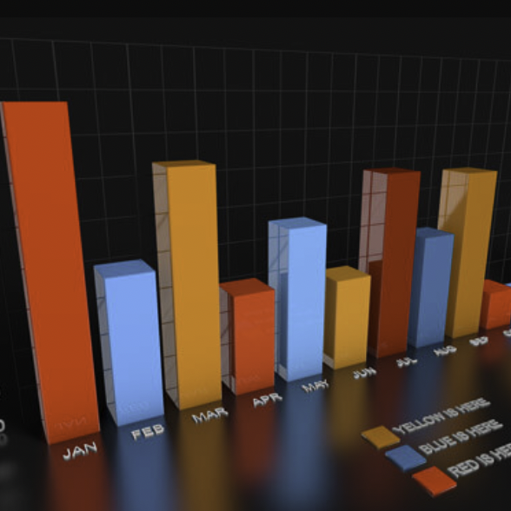
Micro-Level Risks Visualization
Visualization
Suspicious Claims Analysis
A bar chart visualizes the distribution of suspicious claims categorized by type and severity, providing clear insights into risk factors.
This visualization allows targeted resource allocation by identifying which types of claims are most prevalent and which present the highest severity.
By analyzing this data, Company XYZ can prioritize their risk management strategies and allocate resources more effectively to mitigate losses.
Figure: Bar Chart Simple-bar-chart-version-5-graph-c4d-3d-model-infographics-graph-bars-chart-pack - the pixel lab. (n.d.). https://www.thepixellab.net/infographics-graphs-and-charts-pack/simple-bar-chart-version-5-graph-c4d-3d-model-infographics-graph-bars-chart-pack
Notes:
This bar chart breaks down the micro-level risks associated with specific types of suspicious claims. It provides detailed insights into which types of claims are most problematic, allowing us to target our risk management efforts more precisely and allocate resources where they are most needed.

Slide 10

Determination of Key Risk Indicators (KRIs)
Risk Management
Importance of KRIs
Key Risk Indicators (KRIs) are crucial for monitoring risks and providing early warning signals of potential financial exposure.
Dataset Used
The dataset includes vehicle type, average loss, and insurance loss categories, which are essential for identifying relevant KRIs.
Methods and Outcomes
Methods such as PCA, linear regression, and logistic regression will derive KRIs to align with reducing financial exposure and informing decisions.
Notes:
Key Risk Indicators (KRIs) are critical for monitoring and managing risks effectively. Using data from the Insurance Institute for Highway Safety, we applied PCA, linear regression, and logistic regression to identify KRIs that are most indicative of lower total insurance losses. These KRIs will help us minimize financial exposure and make more informed decisions. Methods such as PCA, linear regression, and logistic regression will derive KRIs to align with reducing financial exposure and informing decisions.

Slide 11

Resolver: Risk Management Automation
ERM Tools
Key Features and Benefits
Comprehensive Risk Intelligence: Resolver provides a centralized platform for managing and analyzing risks, enabling informed decision-making.
Advanced analytics for proactive risk assessment: The tool incorporates sophisticated analytical capabilities to identify and mitigate risks before they escalate.
Quantification of risk strategies' impact: Resolver allows for the measurement of the effectiveness of risk management strategies, enhancing transparency and accountability.
Automates risk assessments: By streamlining the risk assessment process, Resolver improves efficiency and reduces manual workloads for the team.
Enhances transparency: The platform offers clear insights into risk management processes, fostering trust and collaboration across departments.
Notes:
Selecting the right ERM tool is essential for improving our risk management. In the following three slides, we evaluated three top tools: Resolver, StandardFusion, and Essential ERM. Each tool has unique strengths that can address our specific needs and enhance our risk management practices.
Resolver is recognized for its comprehensive risk intelligence and advanced analytics for proactive risk assessment. It quantifies the impact of risk strategies, enhancing transparency and efficiency. Benefit to Company XYZ: Automates risk assessments, enhances transparency, and improves efficiency.

Slide 12

StandardFusion: Integrated Risk Management
ERM Tools Overview
Key Features and Benefits of StandardFusion
Platform that centralizes governance, risk, and compliance processes.
Centralized management of risk, compliance, and audit processes to streamline operations.
Scalable for future needs, allowing Company XYZ to adapt to growing regulatory requirements and operational complexities.
Notes:
StandardFusion provides a centralized governance, risk, and compliance platform. It integrates risk, compliance, and audit processes, which reduces complexity and is scalable for future needs. Benefit to Company XYZ: Reduces complexity, supports scalability, and fosters trust.

Slide 13
Essential ERM: Ideal for Small Businesses
ERM Tools
Key Features and Benefits of Essential ERM
Easy setup and deployment, allowing organizations to quickly start managing risks without extensive IT resources.
Dynamic reporting capabilities that facilitate real-time insights into risk management, enhancing decision-making processes.
User-friendly interface designed for simplicity, making it accessible for teams with limited technical expertise.
Ideal for small businesses, providing a cost-effective solution to streamline risk management practices and improve overall efficiency.
Notes:
Essential ERM stands out for its user-friendly setup and dynamic reporting capabilities. It simplifies risk management, making it ideal for companies with limited IT resources. Benefit to Company XYZ: Simplifies risk management with limited IT resources and improves decision-making.

Slide 14
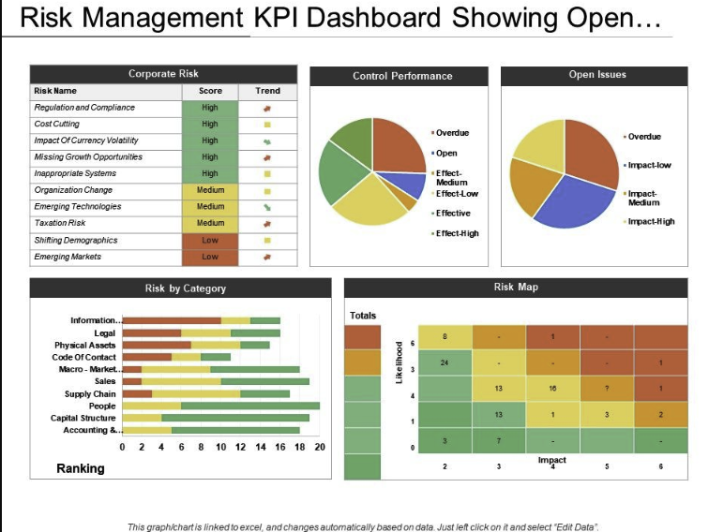
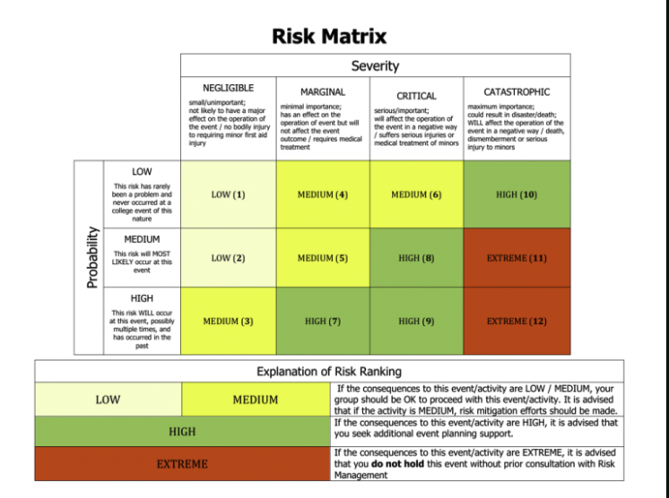
Tailoring Visualizations to Audience
Visualizations
Visualizations for Senior Management
Visualizations for Risk Management Teams
Strategic Dashboard showing high-level summaries and impact.
Focus on key performance indicators (KPIs) to inform decision-making.
Utilize visual elements like pie charts for quick insights.
Detailed Data Tables for in-depth analysis of risk factors.
Interactive Charts to allow exploration of data trends and anomalies.
Incorporate drill-down features for specific claims types and severity.
Figure 1 Sample Dashboards Download free professional powerpoint templates and Google Slides. SlideTeam. (n.d.). https://www.slideteam.net/powerpoint/Risk-Management-Dashboard
Figure 2 Risk Matrix The risk matrix and sample risk assessment tables. studylib.net. (n.d.). https://studylib.net/doc/7239128/the-risk-matrix-and-sample-risk-assessment-tables
Notes:
It’s important to tailor our visualizations to the needs of our audience. For senior management, we use strategic dashboards that summarize high-level risks and impacts. For risk management teams, detailed data tables and interactive charts provide in-depth analysis. This approach ensures that each group receives the information they need in the most effective format.

Slide 15

Promotion of Data Analytics in Risk Management
Recommendations
Necessity of Data Analytics
Data analytics enhances risk assessment accuracy, reduces false positives/negatives, and optimizes resource allocation.
Supporting Evidence
"Advanced analytics techniques, including machine learning models, can significantly enhance risk assessment accuracy" (ISACA Journal, 2021).
Benefits of Data Analytics
Predictive analytics allows proactive identification and prevention, crucial for safeguarding financial security (Sandepudi, 2024).
Notes:
Why do we need Data analytics ? — Data analytics is crucial for enhancing our risk management efforts. By using real data, we can improve risk assessment accuracy, reduce false positives, and optimize resource allocation. As highlighted by industry experts, predictive analytics allows for proactive risk identification and prevention, safeguarding our financial security and improving overall risk management.

Slide 16

Recommendations for Company XYZ
Recommendations
Adopt ERM Tools: Implement Resolver, StandardFusion, and/or Essential ERM based on specific needs.
Integrate Data Analytics: Enhance risk management practices with predictive analytics and automated tools.
Develop KRIs: Utilize identified KRIs for effective monitoring and management of insurance loss.
Expected Outcomes: Improved risk management efficiency, enhanced fraud detection, optimized resource allocation.
Notes:
Here are our recommendations for company XYZ: -Adopt ERM Tools: Implement Resolver, StandardFusion, and/or Essential ERM based on specific needs.
-Integrate Data Analytics: Enhance risk management practices with predictive analytics and automated tools.
-Develop KRIs: Utilize identified KRIs for effective monitoring and management of insurance loss.
And our expected Outcome is going to be Improved risk management efficiency, enhanced fraud detection, optimized resource allocation.

Slide 17
Conclusion
Summary
Company XYZ faces significant challenges in risk management, primarily due to elevated operational losses from fraudulent auto accident personal injury claims. Proposed solutions include the implementation of advanced Enterprise Risk Management (ERM) tools and the development of Key Risk Indicators (KRIs) to enhance monitoring and assessment capabilities.
The integration of ERM tools like Resolver, StandardFusion, and Essential ERM will streamline risk management processes, improve transparency, and support proactive decision-making. By adopting a data-driven approach, Company XYZ can achieve better risk assessment accuracy, optimize resource allocation, and ultimately reduce fraud losses. Stakeholders are encouraged to support the integration of these advanced ERM tools and data analytics for improved risk management effectiveness.
Notes:
In conclusion: Company XYZ faces significant challenges in risk management, primarily due to elevated operational losses from fraudulent auto accident personal injury claims. Proposed solutions include the implementation of advanced Enterprise Risk Management (ERM) tools and the development of Key Risk Indicators (KRIs) to enhance monitoring and assessment capabilities.
The integration of ERM tools like Resolver, StandardFusion, and Essential ERM will streamline risk management processes, improve transparency, and support proactive decision-making. By adopting a data-driven approach, Company XYZ can achieve better risk assessment accuracy, optimize resource allocation, and ultimately reduce fraud losses. Stakeholders are encouraged to support the integration of these advanced ERM tools and data analytics for improved risk management effectiveness.

Slide 18

References
References
Download free professional powerpoint templates and Google Slides. SlideTeam. (n.d.). https://www.slideteam.net/powerpoint/Risk-Management-Dashboard
Gu, Z. (n.d.-b). Complexheatmap complete reference. About. https://jokergoo.github.io/ComplexHeatmap-reference/book/
ISACA Journal. (2021). Risk Assessment and Analysis Methods.
Sandepudi, R. (2024). Predictive Analytics for Risk Management.
Stevens, D. (2024). The Importance of Integrated Risk Management Systems.
Simple-bar-chart-version-5-graph-c4d-3d-model-infographics-graph-bars-chart-pack - the pixel lab. (n.d.). https://www.thepixellab.net/infographics-graphs-and-charts-pack/simple-bar-chart-version-5-graph-c4d-3d-model-infographics-graph-bars-chart-pack
The risk matrix and sample risk assessment tables. studylib.net. (n.d.). https://studylib.net/doc/7239128/the-risk-matrix-and-sample-risk-assessment-tables
Girling, P. X. (2022). Operational Risk Management . Wiley Professional Development (P&T). https://mbsdirect.vitalsource.com/books/9781119836056

Slide 19
Thank You
Conclusion
Thank you for your attention and engagement throughout this presentation.
For further inquiries or additional information, please feel free to reach out to me at:
Rachel Goldsbury
Email: rachel.goldsbury@SNHU.edu
Notes:
Thank you for your attention and engagement throughout this presentation.
For further inquiries or additional information, please feel free to reach out to me by email at rachel.goldsbury@SNHU.edu

Slide 20
Thank you.
Notes:
Thank you.

